Slide 1
Basic Machine Learning Concepts:
Variants and Extensions of Gradient Descent

Slide 2

SGD Extensions and Variants
Several improvements have been proposed to the vanilla SGD algorithm:
Early Stopping
Learning Rate Annealing
SGD with Momentum
Adaptive Learning Rate methods (e.g, AdaGrad, RMSPROP, Adam)
Second Order Methods (e.g., Newton’s methods)

Slide 3
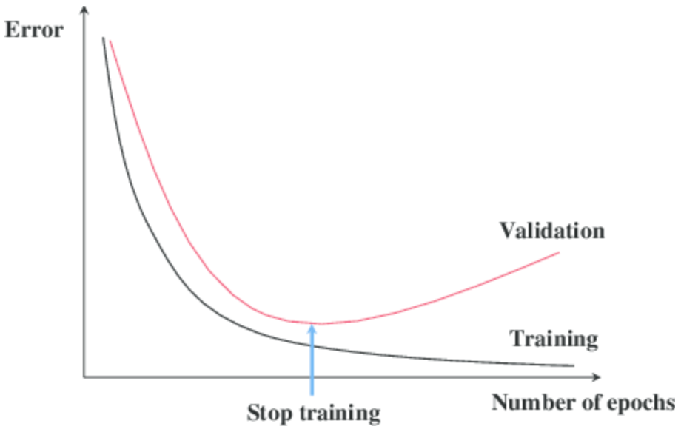

Early Stopping
Often we iterate gradient descent for a predefined number of epochs (which is one of the hyperparameters of the system)
However, if the number of epochs is too high we might end up in an overfitting regime.
If the number of epochs is too low we might end up in an underfitting regime.
We can monitor the performance after each epoch on the validation set and stop training if the validation performance starts to get worse.
This strategy is known as early stopping.
It is one of the most commonly used forms of regularization.

Slide 4
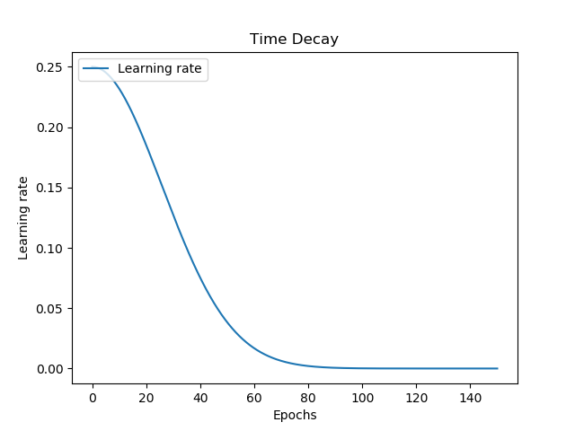
Learning Rate Annealing
Changing the learning rate over the epochs can improve performance and reduce training time.
We normally reduce the learning rate while we train.
This operation is known as learning rate annealing.
Several methods have been proposed, such as exponential decay, linear decay, etc.
Sometimes we reduce the learning rate when some conditions are met (e.g little improvement on the validation set). This is called new-bob annealing.

Slide 5
SGD with Momentum

Slide 6
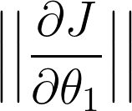
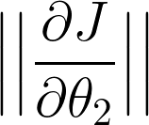
Momentum
SGD has trouble navigating in areas where the surface curves much more steeply in one dimension than in another.
θ2
The partial derivative in the point P wrt θ1 have a small magnitude because the area is rather flat in this dimension
P
The partial derivative in the point P wrt θ2 have a large magnitude because the area is quite steep in this dimension
θ1
Small
As a result, gradient descent will do a little update for θ1 and a larger one for θ2
Large
This causes a slow convergence as we lose time jumping back and forth for the sides of the narrow valley.

Slide 7



Momentum
The method of momentum tackles this problem by accumulating an exponentially-decaying moving average of the past gradients:
Momentum term
Learning rate
Gradient
The velocity vt is the vector containing the updates to perform.
velocity
Previous velocity
This time the updates do not only depend on the learning rate and the gradient, but also on the previous updates vt-1(weighted by a factor γ)
vt

Slide 8
Momentum
The method of momentum tackles this problem by accumulating an exponentially-decaying moving average of the past gradients:
vt
Momentum term
Learning rate
Gradient
vt
velocity
Previous velocity
If the previous update vt points in a direction very different from the current gradient.
If the previous update vt points in a direction similar to the current gradient.
I do a little update
I do a big update

Slide 9
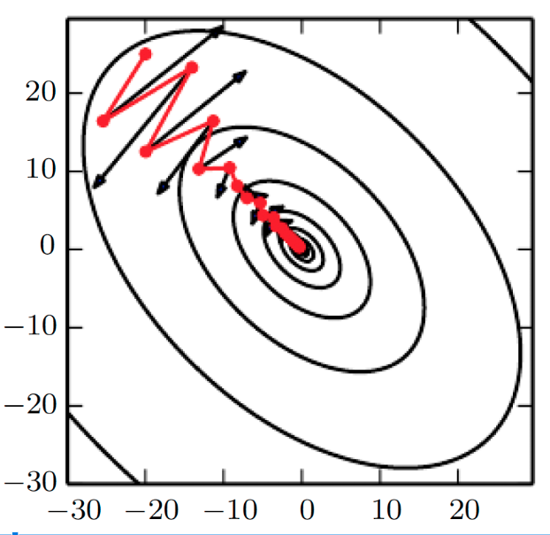
Momentum
SGD
The effect of the momentum is to dampen the oscillations observed with SGD and reach the minimum faster.
SGD with Momentum
Why? Because two consecutive updates point in a very different direction.
As we have seen, this leads to a smaller update that minimizes the jumps over the side of the valley.
The basic idea of the momentum is the following:
When there is an “agreement” between the current and previous gradients, we are “safe” to do a big step.
If there is “disagreement”, it is better to be “prudent” and do little steps.

Slide 10
Nesterov Momentum
A popular variation of the standard momentum is the so-called Nesterov Momentum:
Standard Momentum
Nesterov Momentum
We here try to “anticipate” the next move and apply a “correction factor” to the standard momentum.
This anticipatory update prevents us from going too fast.

Slide 11
Adaptive Learning Rate

Slide 12


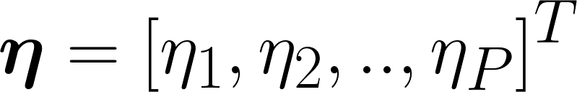
Adaptive Learning Rate
In SGD, the learning rate η is the same for all the parameters θ = [θ1, .., θi, …, θP]^{T}
However, each parameter is different from the others.
Idea: why not using a different learning rate for each parameter?
Standard SGD
SGD with adaptive learning rate
Vector
Element-wise multiplication
Constant Value

Slide 13
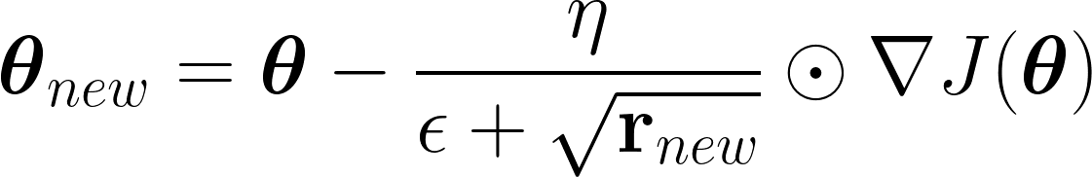
AdaGrad
We cannot set their learning rate manually
In a real case, we have millions or even billions of parameters
We need a method that assigns the learning rate to each parameter automatically.
Adagrad (Duchi et al., 2011) proposed to do it in this way:
Small constant (for numerical stability)
We individually scale each parameter update using the historical values of the squared gradient magnitude.

Slide 14
AdaGrad
Flat region
Small gradients
Large updates
Adagrad
J(θ)
When the squared magnitude of the gradient is, on average, small it is “safe” to do large updates.
θ
Problem:
The updates tend to get smaller and smaller over time as we keep accumulating the squared magnitude of gradients (positive quantity)
Steep region
Large gradients
Little updates
J(θ)
When the squared magnitude of the gradient is, on average, large it is “safer” to do small updates.
This decrease is excessive for many practical applications
θ

Slide 15
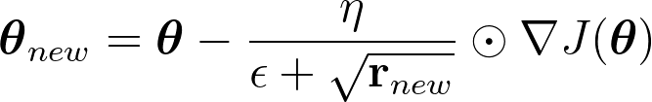
RMSProp
RMSProp mitigates this issue by changing the squared gradient accumulation into an exponential moving average.
Decay Rate
With the exponential moving average, we give more “weight” to the most recent updates and less weight to the older ones.
Good default values are η = 0.001 and ρ = 0.9
RMSProp has been shown to work well in practice for real machine learning methods.

Slide 16
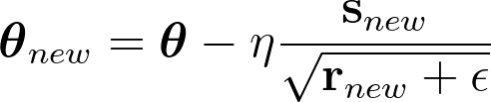
Adam
Adam is an extension of the RMSProp optimizer that also considers momentum.
Similar to momentum (but with exponential weighting)
s
ρ1s
(1-ρ1)g
Previous gradients
Current gradients
The term s is big if the gradient points in the same directions, small if they point if different directions.

Slide 17
Adam
Adam is an extension of the RMSProp optimizer that also considers momentum.
This term is the same as the one used in RMSProp
The term r is big if the squared magnitude of the gradient is big, and small otherwise.

Slide 18
Adam
Adam is an extension of the RMSProp optimizer that also consider momentum.
Suggested values:
ρ1=0.9
ρ2=0.999
η = 0.001
The update considers exponential moving averages
of the gradients (first-order moment) and the magnitude of the gradients (second-order moment).
With RMSProp, the direction of the update depends only on the current gradient (ρ1=0), while the step size also depends on the history of the squared gradient.
With Adam, both the direction of the update and the step size depends on the past gradients.

Slide 19
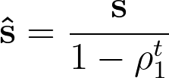
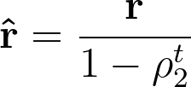

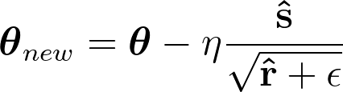
Adam
Normally, s and r are initialized to 0.
This adds a bias, especially during the initial time steps, and when ρ1 and ρ2 are close to 1.
The bias correction has an effect only in the first part of training.
When t grows, s and get closer and closer.
We can compensate for this bias in this way:
Correcting this bias is not that crucial in practice.
Where t is the update number (e.g., first update t=1, second t=2, etc)

Slide 20
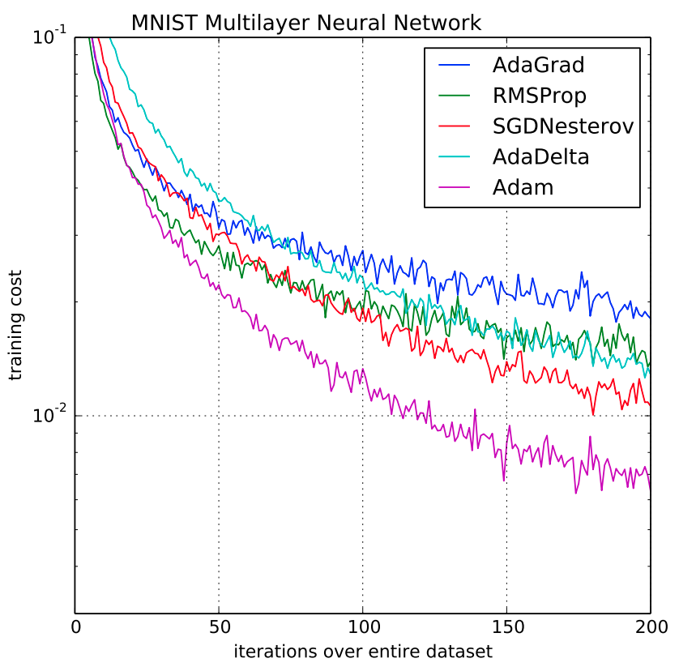


Adam
Adam often works better than other optimizers in real machine learning problems.
It requires setting ρ1, ρ2, η. However, the default suggested values often work well (ρ1=0.9, ρ2=0.999, η = 0.001).
It requires storing s and r which are vectors of size corresponding to the number of parameters to optimize θ.
If we have millions or billions of parameters, this can be quite memory-demanding.

Slide 21
Second Order Methods

Slide 22

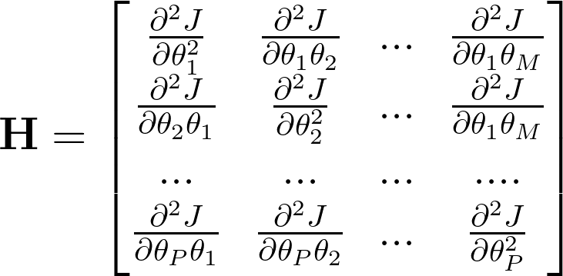
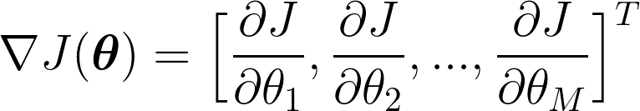


Second Order Methods
We have seen that the gradient (based on first order partial derivatives) provides useful information that we can use to minimize our objective.
What about using the second order derivative?
Hessian
Gradient
The gradient is a vector containing the first order partial derivatives.
The Hessian is a symmetric square matrix of second-order partial derivatives.

Slide 23
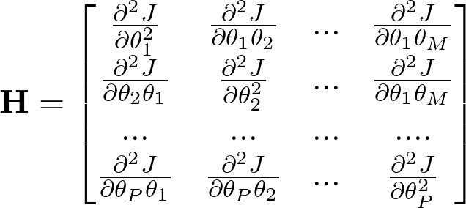
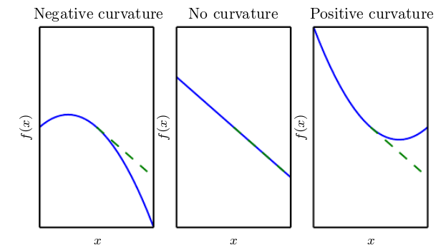
Second Order Methods
The second order derivative tells us how the derivative changes when applying a little change in input x.
Hessian
It measures the curvature of the objective function J(θ) around the point θ.
The Hessian is a square matrix of second-order partial derivatives.
J(θ)
J(θ)
J(θ)
θ
θ
θ

Slide 24
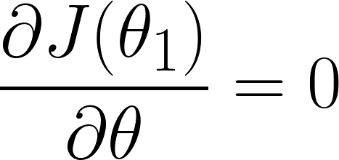
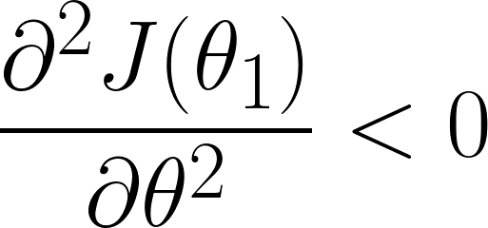
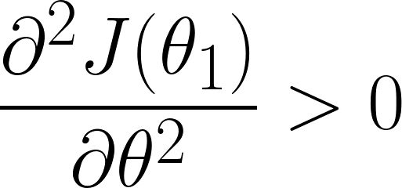
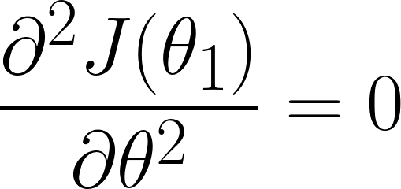
Second Order Methods
Single parameter
The information of the second derivative can be used to classify critical points (second derivative test)
J(θ)
Local Maximum
θ1
θ
J(θ)
Local Minimum
θ1
θ
J(θ)
Inconclusive
Saddle Point or flat region?
θ1
θ

Slide 25
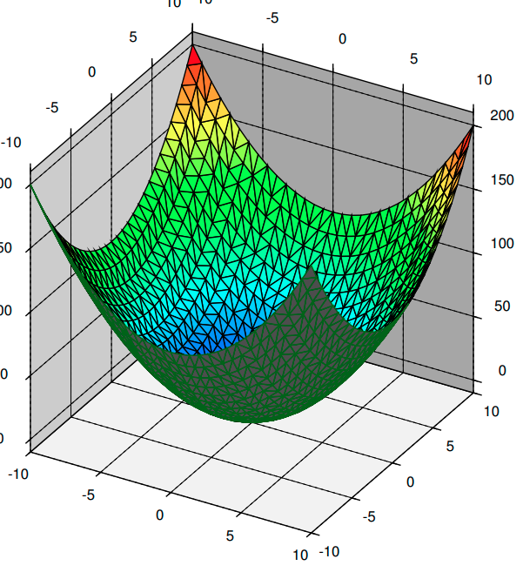
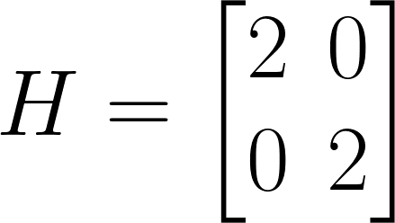
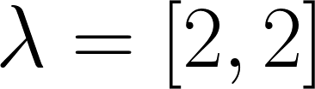
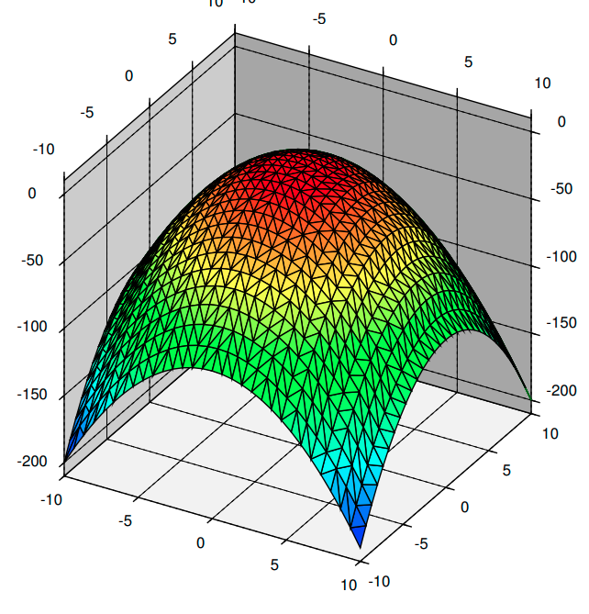
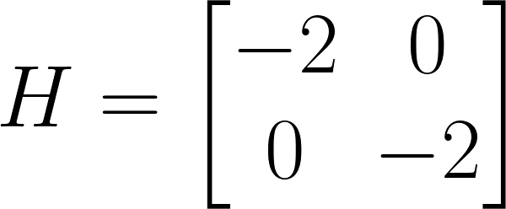
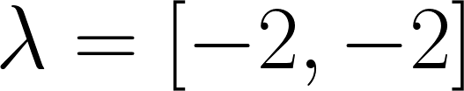
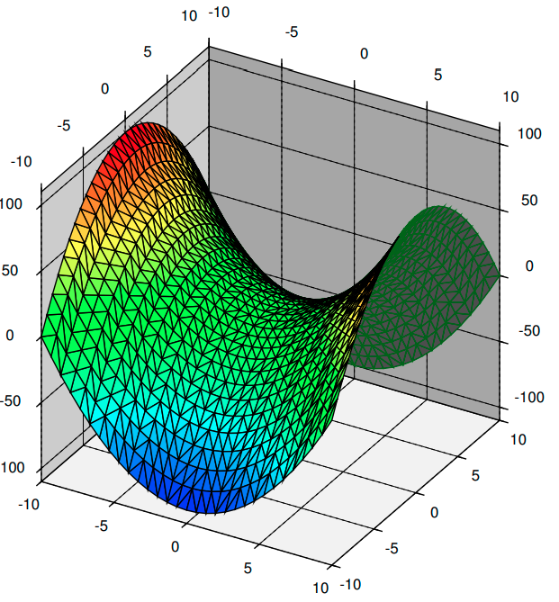
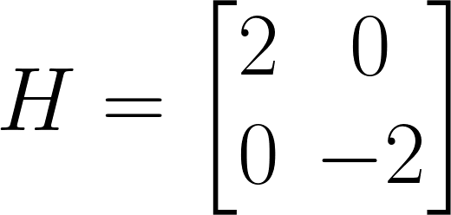
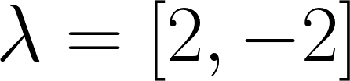
Second Order Methods
Multiple parameters
In a multi-dimensional case, the test involves the eigenvalues
If all eigenvalues are positive
Local Minimum
If all eigenvalues are negative
Local Maximum
If at least one eigenvalue is positive and at least one is negative
Saddle Point
In this special case, we have a diagonal matrix and the eigenvalues are just the elements on the diagonal.

Slide 26
Second Order Methods
Multiple parameters
The condition to have a saddle point is less restrictive than that needed for local minima and maxima.
Intuitively, it will be significantly easier to find points with at least one eigenvalues is positive and at least one negative (saddle points) rather than finding points with all eigenvalues are positive (minima) or negative (maxima).
Now, we can understand better why saddle points are much more common than local minima and maxima in high-dimensional spaces.

Slide 27
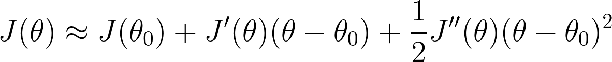

Newton's Method
Single parameter
The optimization methods that use both the gradient and the Hessian are called second order methods.
A popular one is called Newton’s method.
We can approximate the objective with a Taylor expansion (up to the second order) and jump directly into the expected minimum value.
Jquad(θ) - quadratic approx
Quadratic function
J(θ) - actual objective
If the function is convex around θ0 (positive second derivative), we can find the minimum by solving:
θ0
θ*
θ

Slide 28
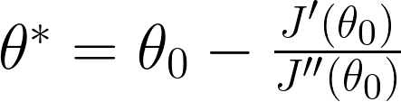
Newton's Method
Single parameter
Jquad(θ) - quadratic approx
Quadratic function
J(θ) - actual objective
Minimum
θ0
θ*
θ
The update equation is similar to gradient descend.
The main difference is that the “learning rate” is not specified but automatically guessed using by the second derivative.
Similar to gradient descend, we can iterate multiple times until convergence

Slide 29



Newton's Method
High-dimensional case
Quadratic approximation
If H is positive definite, this will find the minimum.
θ0
Algorithm:
Compute the Gradient.
Compute the Hessian
Compute Hessian Inverse.
Update parameters.
θ*

Slide 30
Newton's Method
Issues
Newton’s method sounds appealing, but in practice, it suffers from several issues:
If the second derivative is negative, we reach a local maximum and not a local minimum.
J(θ)
In a multi-dimensional case, this happens if the eigenvalues of H are not all positives.
θ0
θ*
θ
This happens for instance, near saddle points.
Newton's method is thus sensitive to saddle points (that are a big issue in high-dimensional spaces).
Standard SGD is less sensitive to this issue.
Several solutions have been proposed to mitigate this issue (e.g, Hessian regularization).

Slide 31
Newton's Method
Issues
The other issue is the computational complexity that increases significantly with the number of parameters:
Gradient Computation: O(N)
Quasi-Newton methods attempt to the computational burden by approximating the Hessian.
Examples of techniques are Conjugate Gradients and the BFGS Algorithm.
Hessian Computation: O(N^2)
Hessian Inversion: O(N^3)
The objective should be twice differentiable.
Numerical instability with second derivative close to zero.

